Slide 1
Eco-forestry Research Station (ERS), Sukna, Darjeeling (West Bengal)
Eco-forestry Research Station (ERS), Sukna, Darjeeling (West Bengal), a research centre under ICFRE-Institute of Forest Productivity holds the position of tremendous importance being situated in one of the world’s 36 global biodiversity hotspots at the foothills of Eastern Himalayas/North Bengal in the Mahananda Wildlife Sanctuary of Darjeeling district of West Bengal. The region is renowned for its richness in plant biodiversity, diverse ecosystem and global recognition. The Darjeeling district has highest forest cover (74.62 sq. km) in terms of percent of geographical area in the state of West Bengal contributing major timber and non-timber forest produce (NTFP) production to the state and are integral in livelihood pattern and biodiversity conservation of the region. The research station has an experimental plot of 6.25 ha at Uday Singh Jote, Dagapur.

Slide 2
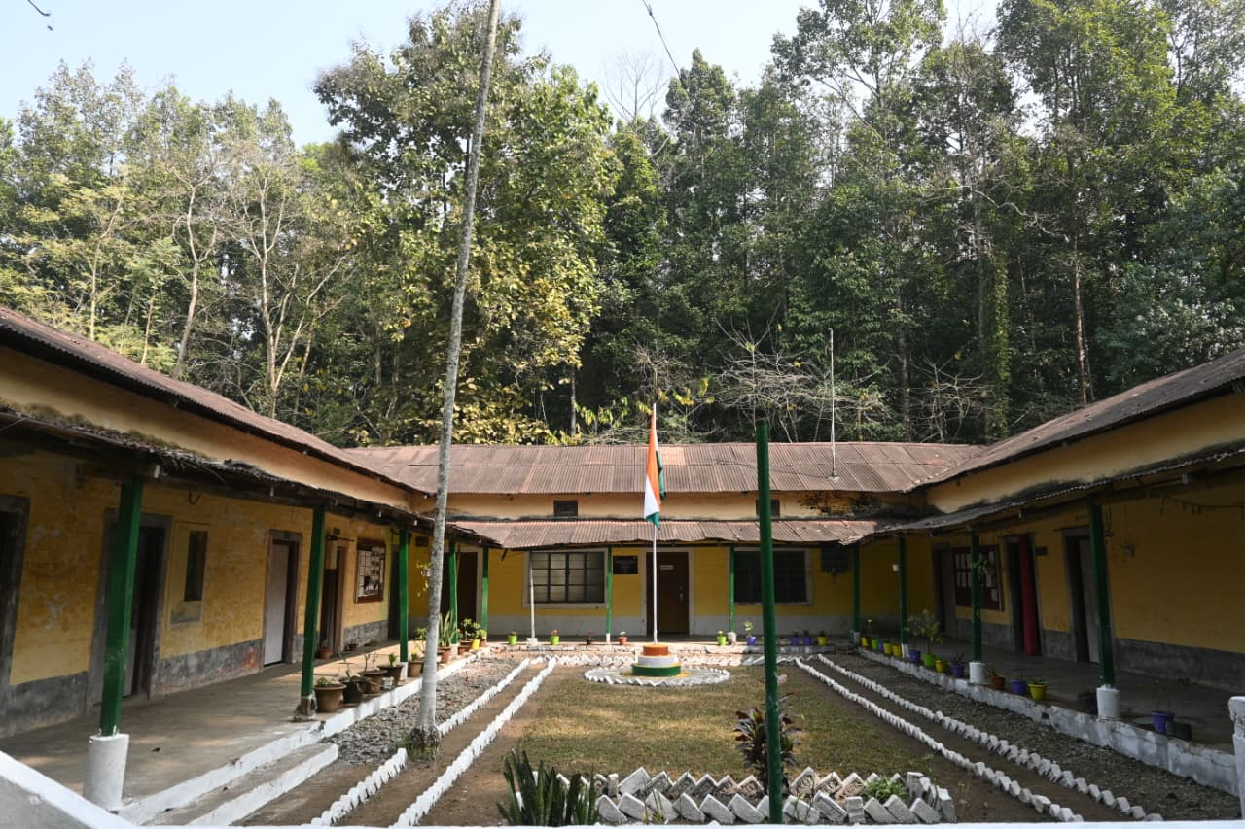
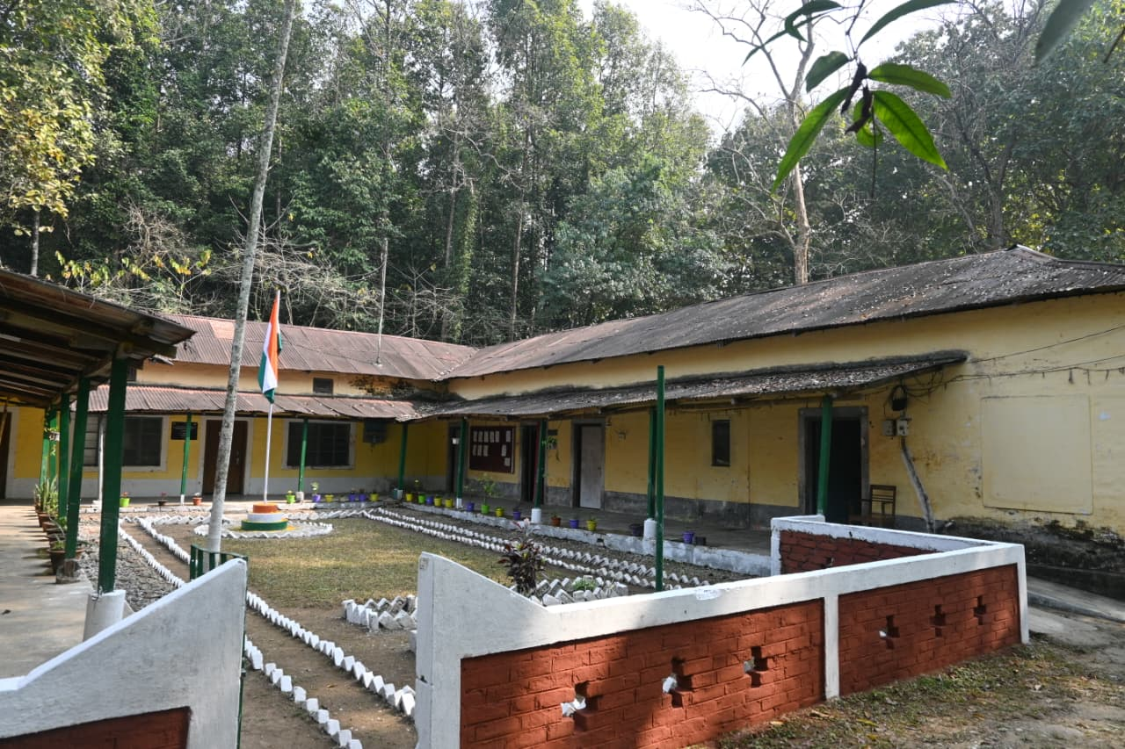
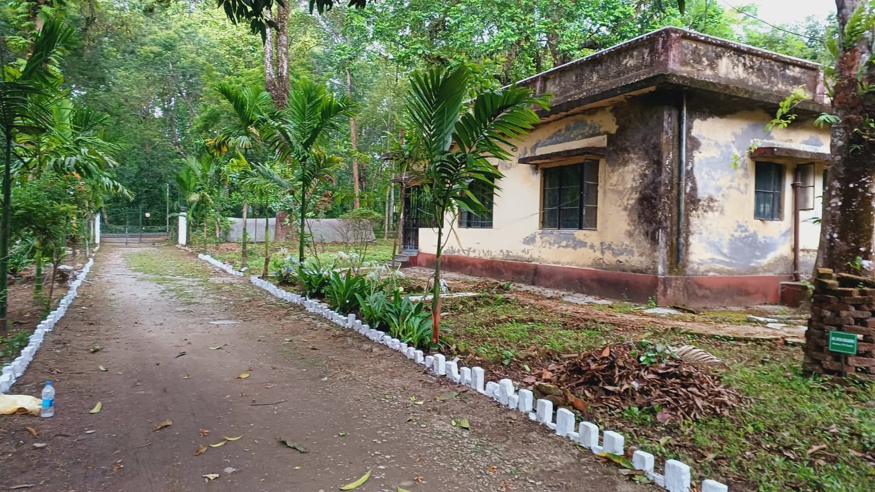
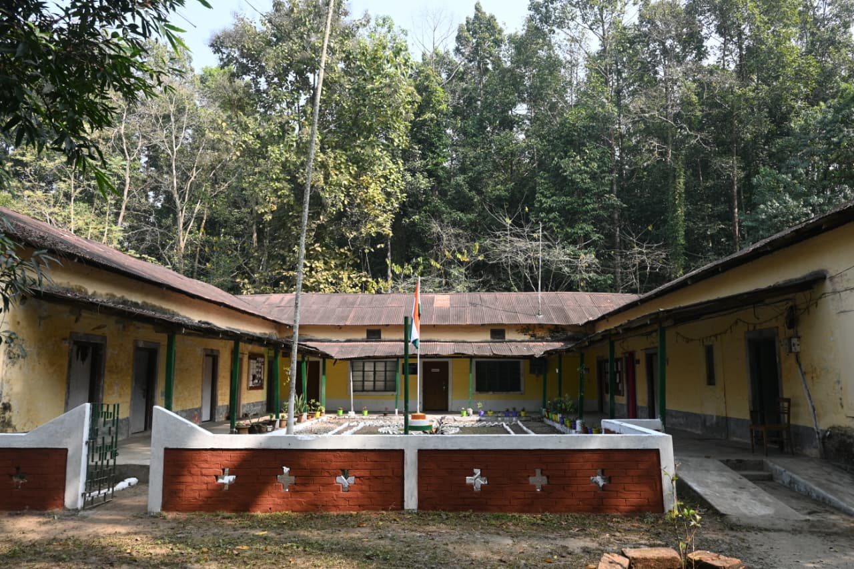
Photos of Office Campus of ERS, Sukna

Slide 3
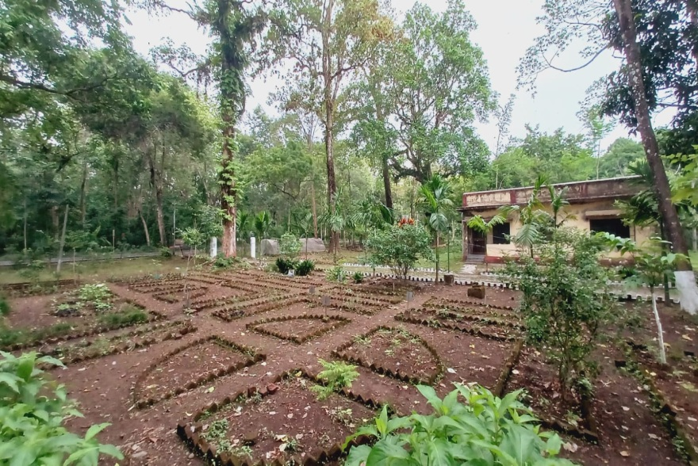
Photos of Office Campus of ERS, Sukna

Slide 4
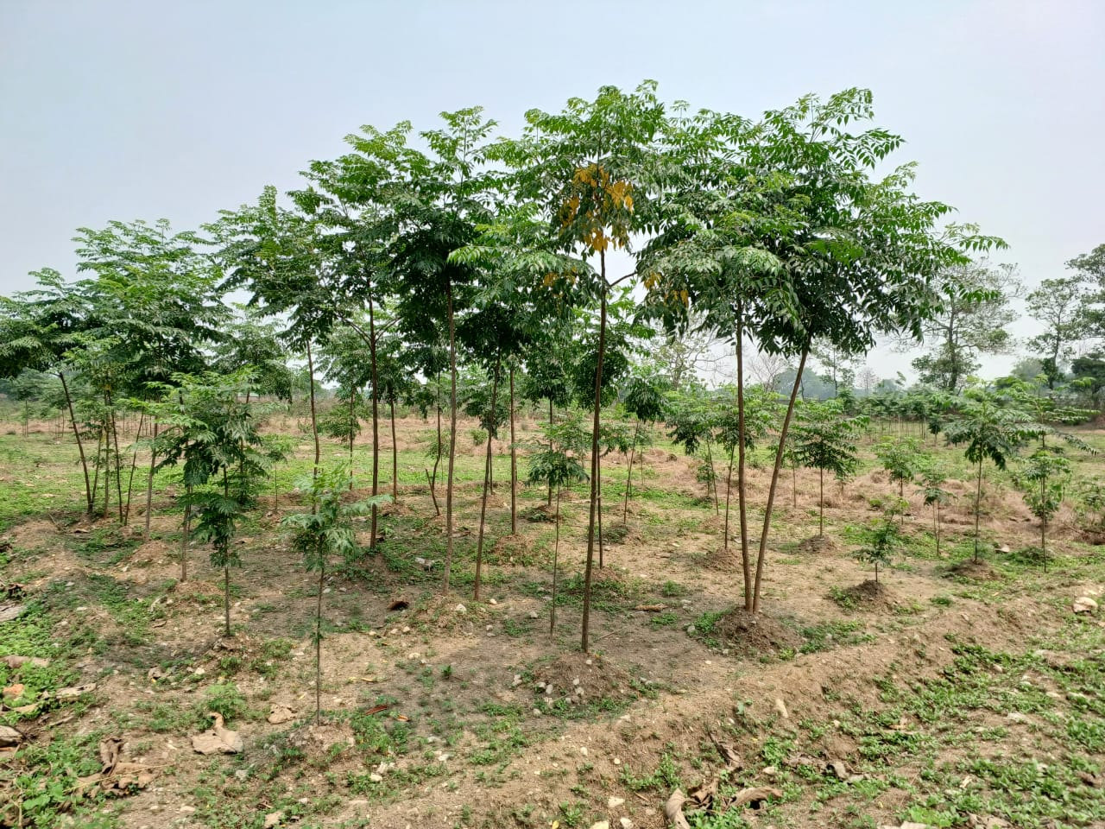
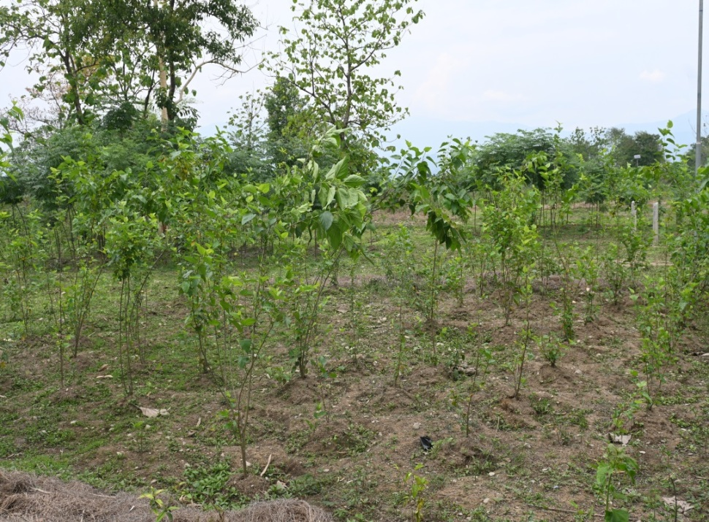
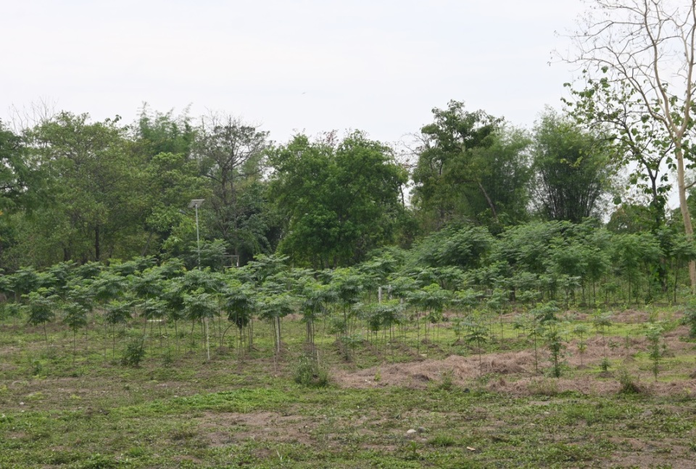
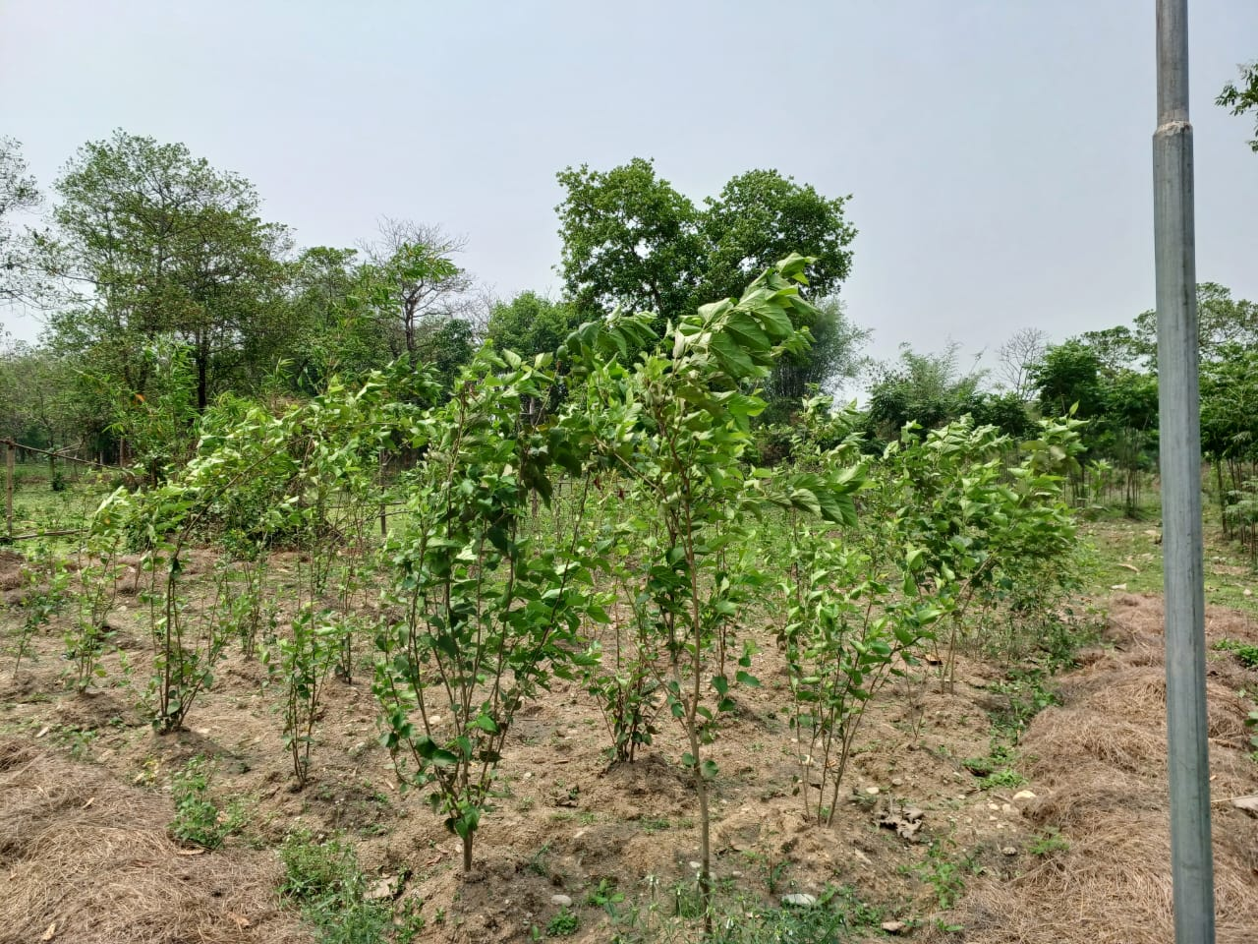
Photos of experimental plot of Uday Singh Jote, Dagapur

